Slide 1

Introduction to Wind Turbine Power Prediction

Slide 2
Importance of Accurate Power Prediction
Optimized Operations
Improved Grid Integration
Accurate power prediction allows wind farm operators to optimize turbine operations, minimize downtime, and maximize energy production.
Precise forecasts enable grid operators to better integrate wind power, balancing supply and demand to ensure reliable electricity.
Revenue Maximization
Reduced Maintenance Costs
Accurate predictions help wind farm owners secure more lucrative power purchase agreements and maximize their return on investment.
Predictive models allow for proactive maintenance, reducing unplanned outages and extending the lifespan of wind turbine components.

Slide 3
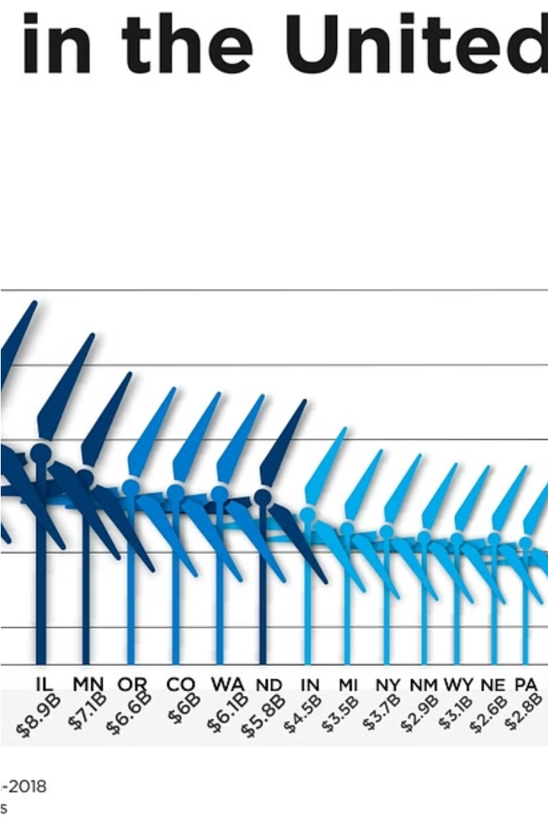
Key Factors Affecting Wind Turbine Power Output
Wind Speed: The primary driver of wind turbine power, higher wind speeds lead to exponentially greater power generation.
Wind Direction: Optimal alignment of the turbine with the prevailing wind direction maximizes energy capture.
Air Density: Denser air at lower altitudes or in cooler temperatures contains more kinetic energy to drive the turbine.

Slide 4




Data Collection and Monitoring Techniques
Wind Measurement
Remote Sensing
Turbine Monitoring
Weather Stations
LiDAR technology scans the airflow, providing detailed wind profiles and enabling more accurate wind modeling.
On-site weather stations collect meteorological data like temperature, humidity, and atmospheric pressure to enhance the prediction models.
Anemometers measure wind speed and direction at the turbine site to provide crucial data for power prediction.
Sensors installed on the turbine continuously measure power output, vibrations, and other parameters for real-time analysis.

Slide 5
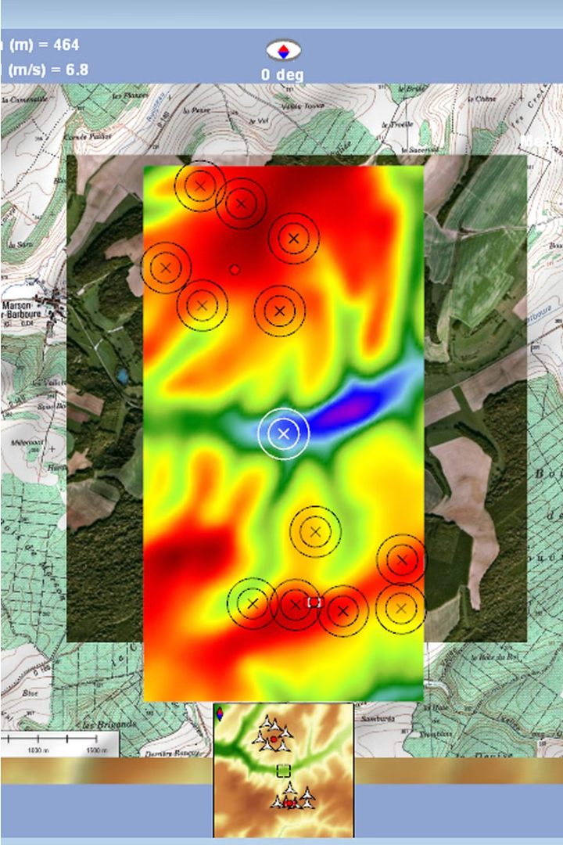
Wind Resource Assessment and Modeling
Accurate wind resource assessment is crucial for predicting wind turbine power output. This involves comprehensive data collection on wind speed, direction, and other factors through on-site monitoring and advanced modeling techniques.
Detailed wind flow simulations, coupled with historical weather data, enable precise mapping of the wind regime across a prospective wind farm site. Advanced computational fluid dynamics models help analyze complex terrain and identify optimal turbine placement for maximum energy generation.

Slide 6
Machine Learning Algorithms for Power Prediction
Regression Models
Neural Networks
Tree-Based Methods
Ensemble Techniques
Advanced deep learning models can capture highly nonlinear patterns in wind data, leading to more accurate short-term and long-term power predictions.
Popular regression algorithms like linear, polynomial, and support vector regression can effectively model the complex relationship between wind speed, turbine parameters, and power output.
Decision trees and random forests excel at handling diverse data inputs and can provide valuable insights into the most important features driving wind turbine power.
Combining multiple machine learning models through ensemble methods can boost prediction accuracy and robustness, making the forecasts more reliable.

Slide 7
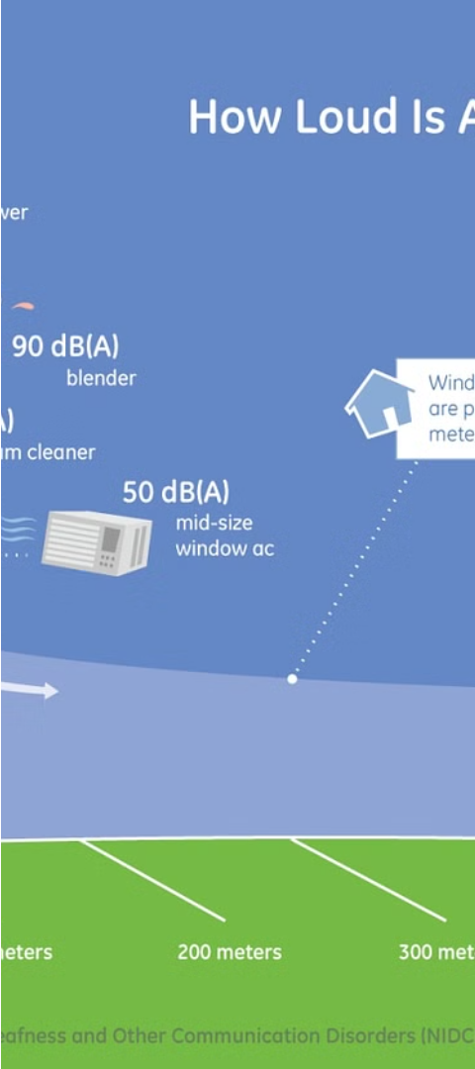



Integrating Weather Forecasts and Historical Data
Leverage Weather Forecasts
Incorporate reliable weather predictions to anticipate changing wind patterns and optimize power generation.
Leverage Historical Data
Analyze past performance data to identify trends and patterns that can improve future power forecasting.
Data Integration
Seamlessly combine weather forecasts and historical data to create comprehensive predictive models for wind turbine power output.

Slide 8
Validation and Accuracy Evaluation
Validating the accuracy of wind turbine power prediction models is crucial to ensure reliable and efficient wind farm operations. This involves comparing predicted power output with actual field measurements, using key performance metrics such as mean absolute error, root mean square error, and R-squared values.
Performance Metric
Description
Ideal Value
Mean Absolute Error (MAE)
Average absolute difference between predicted and actual values
Low
Root Mean Square Error (RMSE)
Square root of the average squared difference between predicted and actual values
Low
R-Squared (R²)
Measure of the proportion of variance in the actual data that is predictable from the model
High (close to 1)
Regularly evaluating these metrics and comparing them to industry benchmarks helps identify areas for model improvement and ensure the reliability of wind turbine power predictions.

Slide 9
Optimizing Wind Farm Operations
Real-Time Monitoring
1
Continuously track turbine performance and environmental conditions
Predictive Maintenance
2
Forecast and schedule proactive repairs to minimize downtime
Energy Optimization
3
Dynamically adjust turbine settings to maximize energy output
Optimizing wind farm operations is essential for maximizing energy production and minimizing costs. By leveraging real-time monitoring, predictive maintenance, and advanced energy optimization algorithms, wind farm operators can ensure their turbines are running at peak efficiency and reliability, ultimately boosting profitability and reducing the environmental impact of wind power generation.

Slide 10

Conclusion and Future Trends
As wind turbine power prediction continues to evolve, new opportunities and challenges emerge. Integrating advanced machine learning algorithms with real-time weather data will unlock unprecedented accuracy and reliability in forecasting power output.

